Slide 1

STUDENT DETAILS
Name : VARSHITHA Y S
Skills Build Email ID : varshitha123457@gmail.com
College Name : SJB Institute of Technology
College State : Karnataka
Internship Domain : Data Analytics
Internship Start Date: 09/06/2023
Internship End Date: 21/07/2023

Slide 2
SUPER STORE DATA ANALYSIS
Problem Statement: The primary objective of this analysis is to identify the key factors impacting sales and profitability in the Superstore business. We aim to uncover patterns, trends, and opportunities for improvement to optimize business strategies and maximize profitability.

Slide 3
AGENDA
Project Overview
End Users
​Solution and Value Proposition
Customization and Uniqueness
​Modelling
Results
Links

Slide 4
PROJECT OVERVIEW
Project Title: Super Store Data Analysis
Objectives:
Identify the top-performing product categories, regions, or customer segments
Analyze sales performance, profitability, and factors impacting business success
Uncover trends, patterns, and opportunities for improvement
Provide actionable insights to optimize business strategies and maximize profitability

Slide 5
Dataset Description:
The dataset used for this analysis is sourced from the Superstore database. It contains comprehensive information about sales transactions, including sales category states, city, Segments, Regions, Profit product categories, sales etc.. The dataset consists of 9977 rows and 13 columns.

Slide 6
WHO ARE THE END USERS of this project?
The end users of this project include:
Business Managers: This analysis will help business managers seeking insights for optimizing strategies and maximizing profitability.
Marketing and Sales Teams: Marketing and sales teams can benefit from the analysis by gaining insights into top-performing product categories, regions, or customer segments to focus on and improve targeting and sales strategies.
Data Analysts: The project can serve as a reference for data analysts in understanding data cleaning, exploratory data analysis, and statistical analysis techniques.
Decision-Makers: The insights generated from this analysis can support decision-makers in making informed business decisions based on data-driven insights

Slide 7
SOLUTION AND ITS PROPOSITION
Solution: My analysis provides valuable insights into sales performance, profitability, and factors impacting business success. By leveraging data cleaning, exploratory data analysis, and visualization techniques.
Value Proposition:
Optimize Profitability
Enhanced Sales Performance
Improves Customer Satisfaction
Data Analysis Reference
Competitive Advantages

Slide 8
CUSTOMIZATION &UNIQUENESS
How did you customize the project and make it your own:
Selected relevant dataset (Sample Superstore)
Applied data cleaning and exploration techniques
Customized visualizations for clarity and aesthetics
Generated valuable insights and actionable recommendations
segments to focus on and improve targeting and sales strategies.

Slide 9
MODELLING
Gather Data :
Obtained the Sample Superstore dataset as the primary data source for the analysis.
Understand Data:
Explored the dataset to gain a comprehensive understanding of its structure and variables .
Reviewed data types, distributions, Columns, rows and any initial observations or patterns.
Data Cleaning:
Conducted data cleaning procedures to ensure data quality .
Handled missing values, removed duplicates, and performed necessary data transformations.

Slide 10
Statistical Analysis:
Descriptive Analysis : Utilized descriptive statistical techniques, such as calculating mean, median, and standard deviation, to summarize and explore key variables.
Generated descriptive statistics to understand the central tendency, variability, and distribution of the data.
Visualization:
Utilized various visualization techniques, including bar plots, pie charts, line plots, and scatter plots, to effectively communicate the findings of the analysis.
Created visually appealing and informative graphs and charts to present the insights to stakeholders.

Slide 11
RESULTS AND OUTPUTS

Slide 12
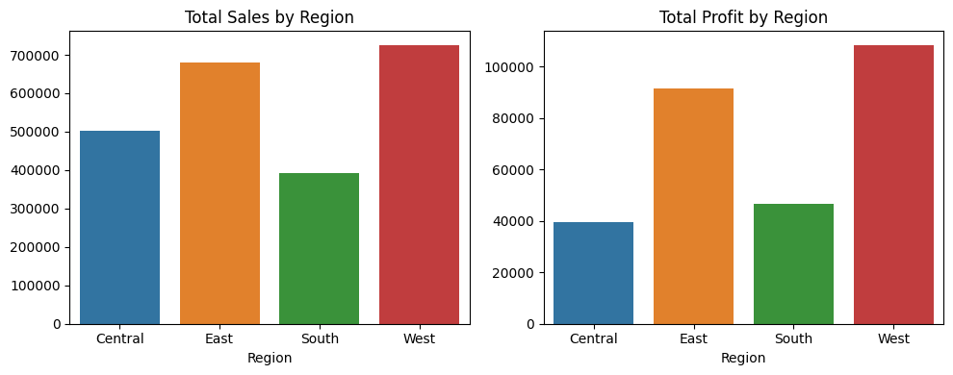
Profit Analysis
Analyzed the sales and profit distribution by region. The left chart displays the total sales by region, highlighting regions with high sales volume. The right chart shows the total profit by region, identifying regions with strong profit margins. These insights inform strategic decision-making, resource allocation, and revenue optimization.

Slide 13
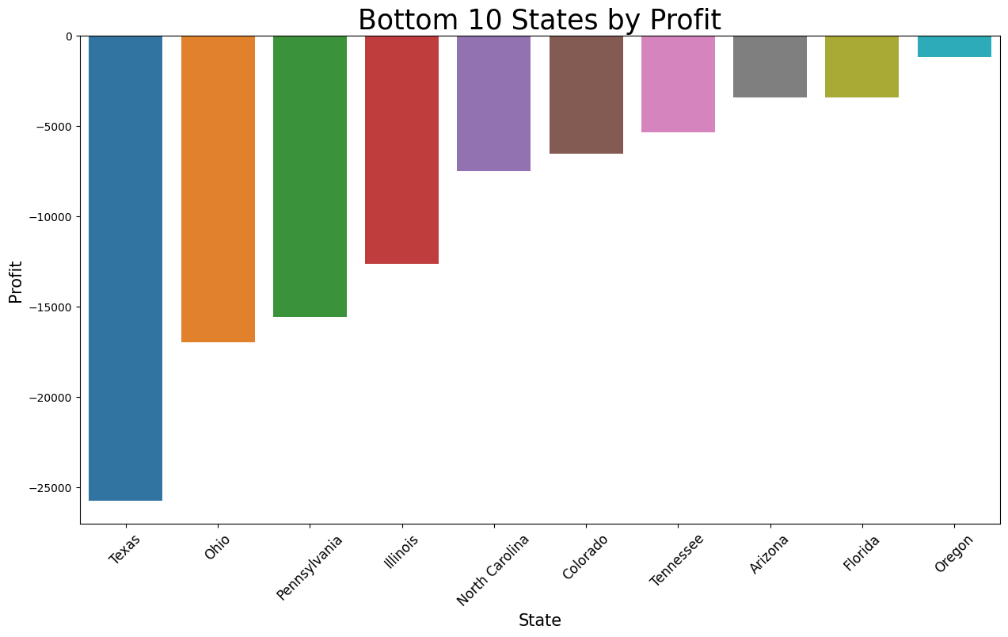
I have analyzed the profitability of different states and identified the bottom 10 states based on profit generated.
The analysis of the bottom 10 states by profit provides valuable insights into areas where the company can focus on improving profitability

Slide 14
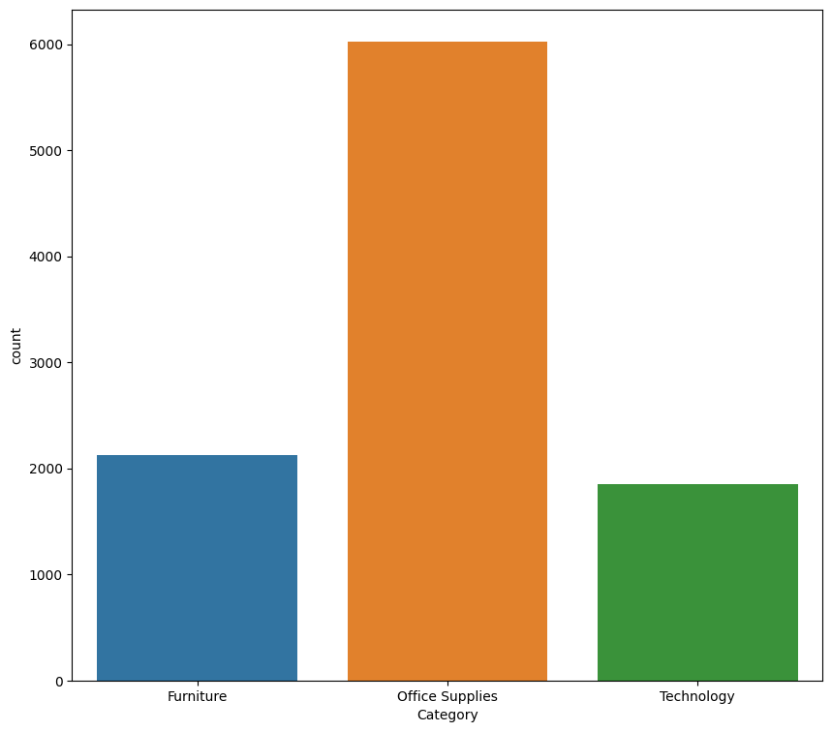
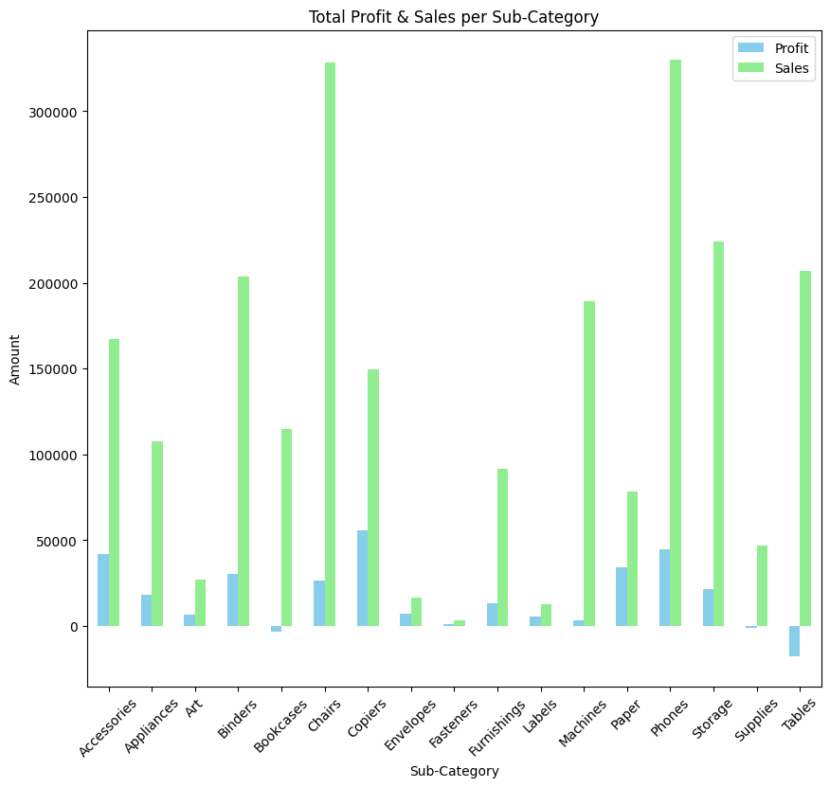
Product Category Analysis
In the product category analysis, we examined the distribution of products across different categories. The bar plot showcases the count of each product category, providing insights into the composition and prevalence of products in the dataset.

Slide 15
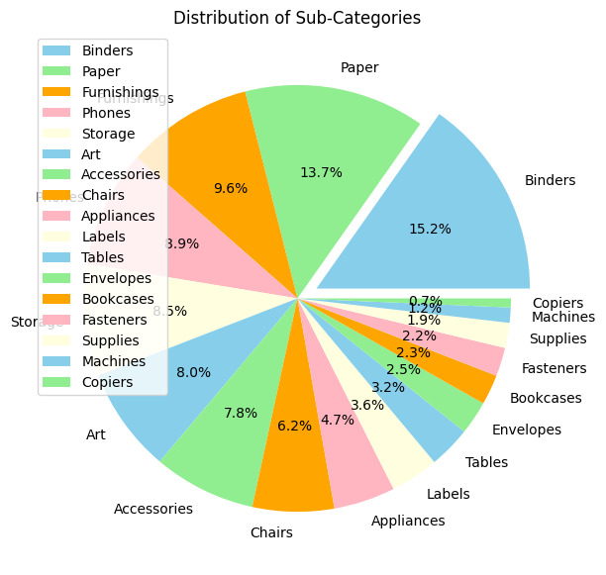
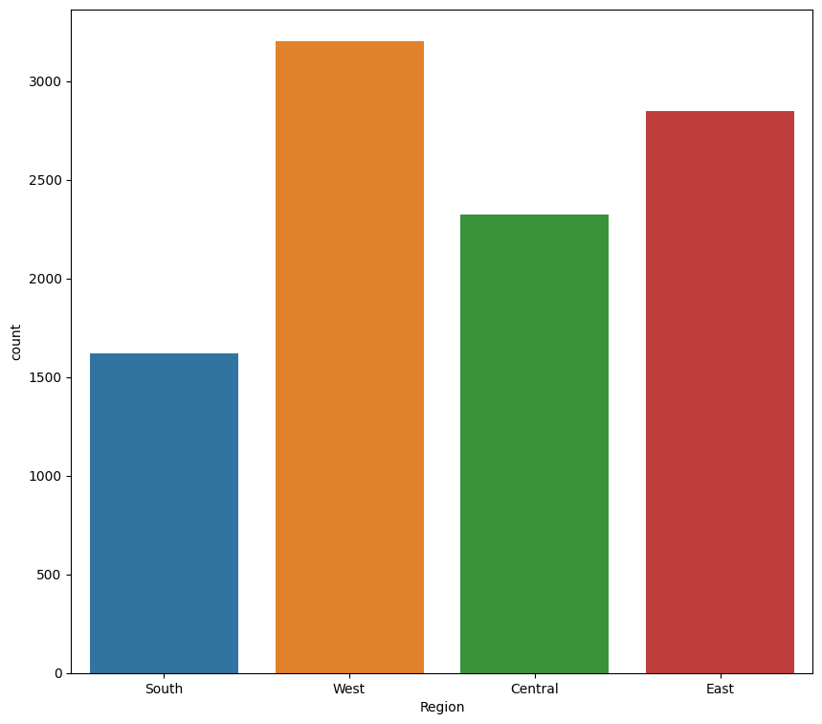
Distribution Analysis
Figure: Distribution of Sub-Categories
Figure: Distribution of Sales by Region

Slide 16
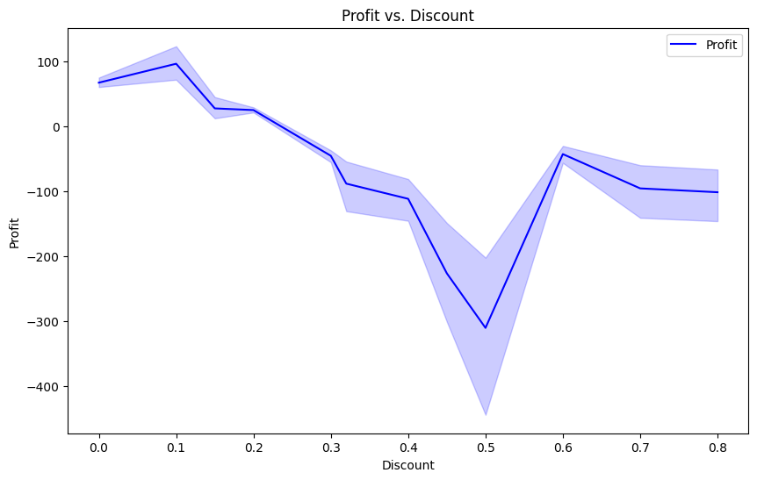
Additional Visualizations
Figure: Profit and Purchasing Patterns by Segment
Figure: Profit vs. Discount

Slide 17
CONCLUSIONS
The analysis reveals that the Home Office segment contributes significantly to the overall profit.
Profit is high in South & less in central part
Highest profit is earned in copiers while selling price for chairs & phones is extremely high compared to other products
Technology category is more number in count
In region wise more count is in west region and many more conclusions can be made.

Slide 18
LINKS
https://github.com/Varshithays/Superstore_dataAnalysis/tree/main
https://www.kaggle.com/
https://www.python.org/
https://skillsbuild.org/
https://jupyter.org/try
https://www.ibm.com/products/watson-studio

Slide 19
THANK YOU

